Slide 1


Basic Details of the Team and Problem Statement
Intel® Unnati Industrial Training 2025
Problem Statement Title: Enhancing Customer Experience with AI-Driven Insights
(Our AI-driven solution predicts telecom customer churn, helping businesses proactively retain at-risk users and boost satisfaction.)
Team Name: Quarks
Team Leader Name: Adarsh Kumar
Team Members: Jay Dhodi, Manish Prasad
Institute Name: Parul Institute of Technology

Slide 2
Intel® Unnati Industrial Training 2025
Idea/Approach Details:
Data Preprocessing: Handled missing values, encoded categories, and scaled features.
Model Training: Used Random Forest Classifier to predict churn.
Model Conversion: Converted the model to ONNX format.
Optimization: Applied Intel® OpenVINO™ for faster, low-latency inference.
Web Interface: Built a Gradio web interface for real-time predictions and visualizations.
Benchmarking: Compared inference speed before and after optimization.
Insights & Explainability: Showed feature importance and churn prevention tips.

Slide 3
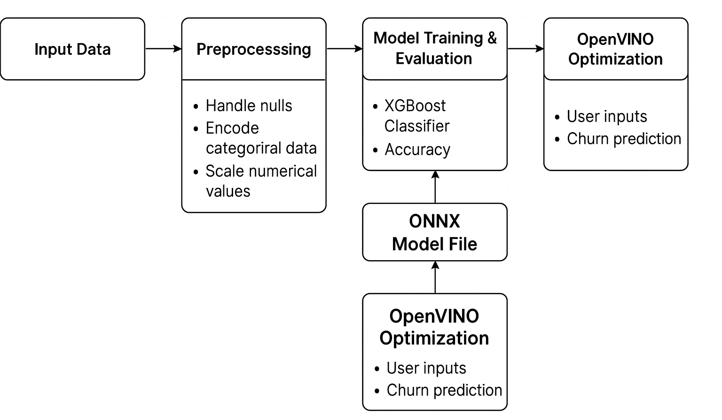
Intel® Unnati Industrial Training 2025
Architecture

Slide 4
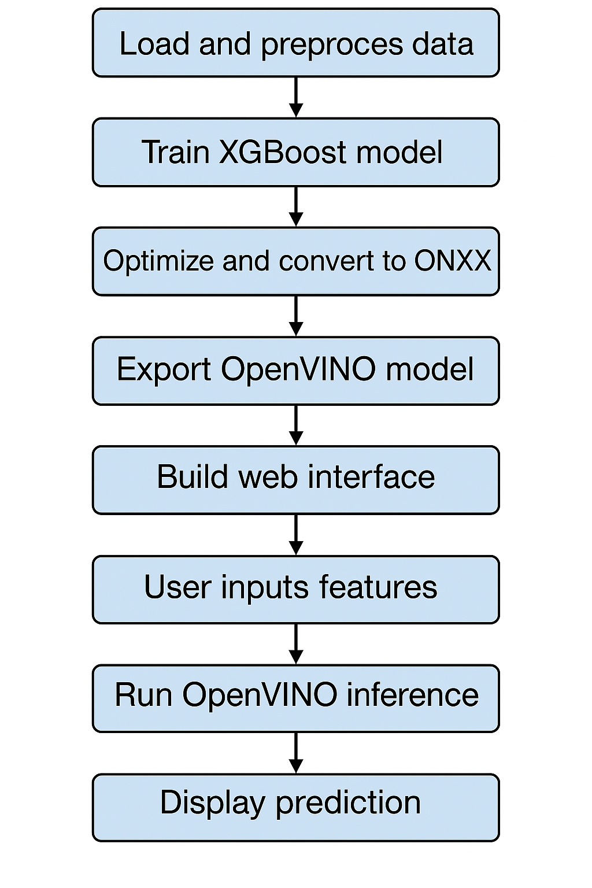
Intel® Unnati Industrial Training 2025
Flow of code :

